Slide 1

DLIP Final Project
Camera-Based System for Automatic Pin Mapping on Breadboards
School of Mechanical and Control Engineering
Prof. YoungKeun-Kim
21900179 JongHyeon-Kim
22000188 ChanJung-Kim
Handong Global University

Slide 2
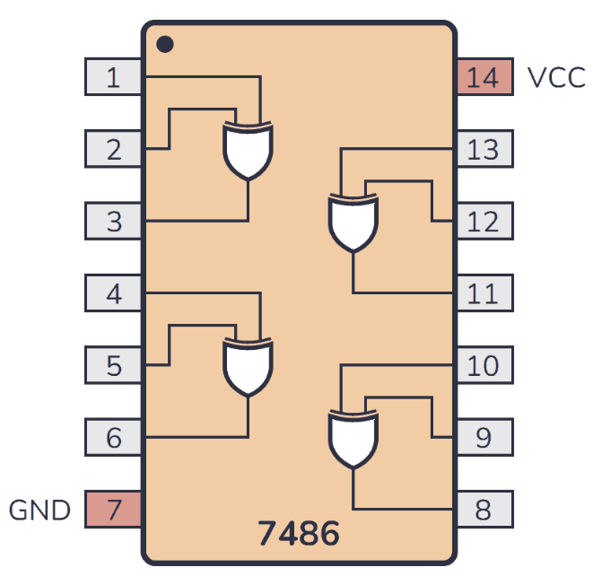
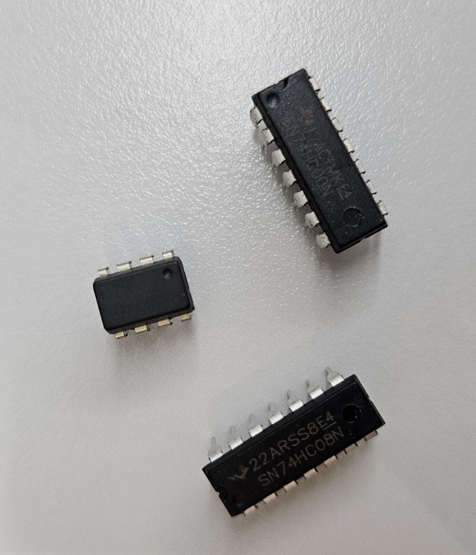
Introduction
Background
Various forms of integrated circuit (IC) chips are essential components and commonly used at school experiment and an industrial site.
Problem Description
Hard to identify a IC chip
Not convenient to look for datasheet
Project Objective
IC chips and its node are identified by corresponding mode. User may pause or resume the program and save the image.
Handong Global University

Slide 3
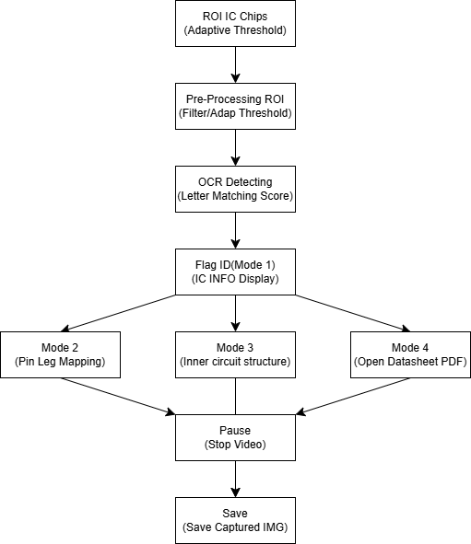

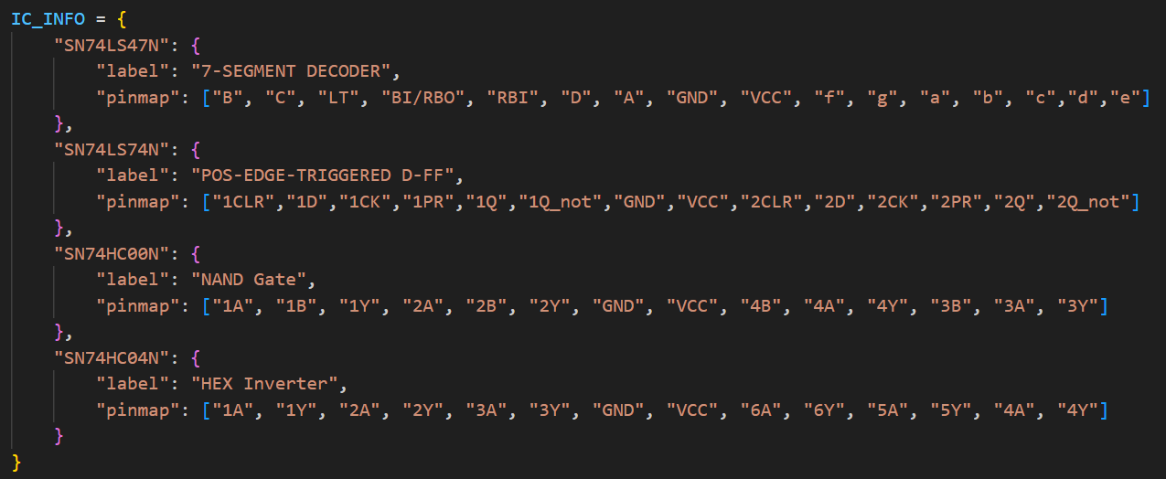

Introduction
Flow Chart
Key Advantages
No webcam required
Runs with your phone camera — no extra hardware required.
Easily Customizable
Add new chips by updating an `IC_INFO` dictionary.
Multi-Function Support
Includes various modes to cover all user needs.
Handong Global University

Slide 4
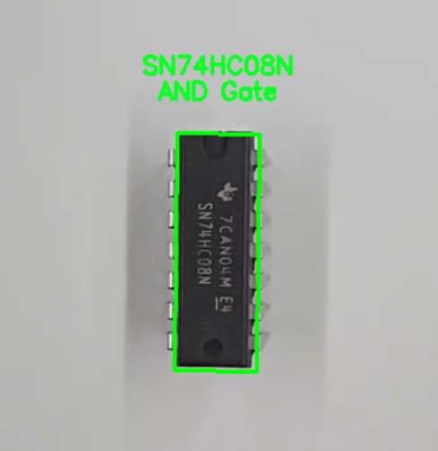
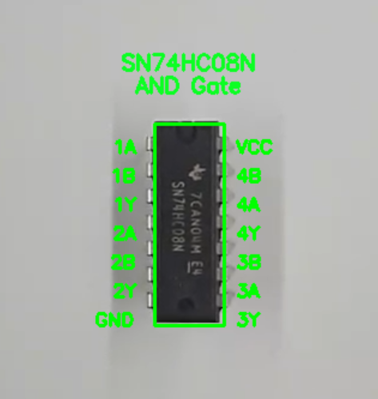
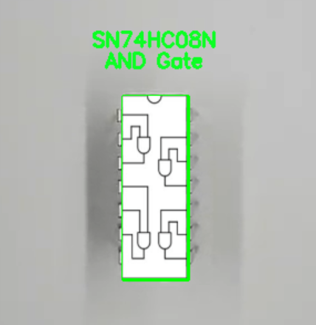
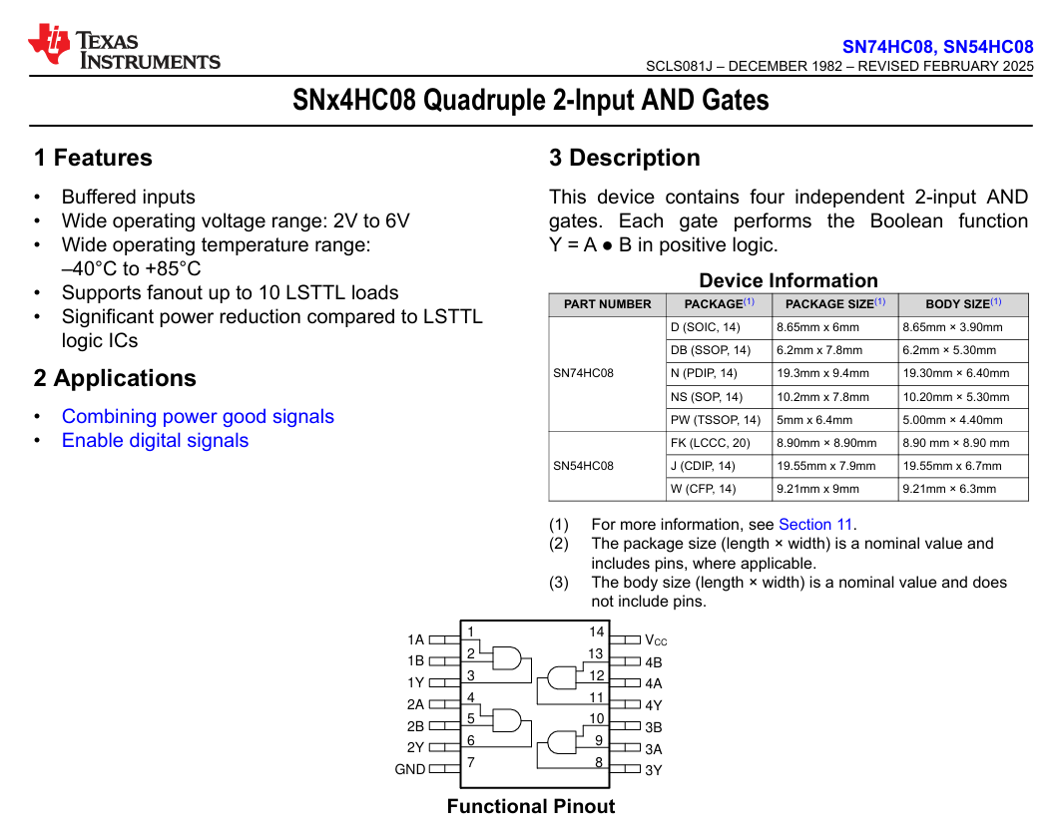
Mode Description
Mode 1
Mode 2
Mode 3
Mode 4
Default Mode
Detect IC Name
Match to Function Type
Toggle Display Mode
Pin Identification
Oriented Text Rendering on IC
Toggle Display Mode
Overlay Internal Circuit Diagram
Retrieve Matching Datasheet
Open PDF for Detailed Specifications
Handong Global University

Slide 5
Function Description
Pause / Resume
Save
Exit
Toggle behavior: pressing ‘p’ pauses the program, and pressing ‘r’ resumes it.
Only one is active at a time.
Used to freeze processing for inspection or saving.
Triggered by pressing ‘s’ while paused.
Prompts user to enter a filename.
Saves the current frame as a .png image.
Press ‘ESC’ (Escape key).
Immediately terminates the program, regardless of current mode or state.
Handong Global University

Slide 6
Demo Video
https://youtu.be/vTJCyv63dBk?feature=shared
Handong Global University

Slide 7
Conclusion
Objectives Summary
Challenges
Improvement
Successfully developed a machine-vision system which detects IC chips
Provides multiple mode and functions to increase user’s convenience
Heavy pre-processing before Tesseract OCR
Multiple filtered images used to ensure OCR accuracy
Difficulty in rotated text placement (coordinate transform, DCM)
Need to improve operation speed
Need to improve exact node position
Need to improve
IC indicating accuracy
Handong Global University

Slide 8
Thank You!!
Handong Global University

